Slide 1


Internship/Project (3180701) Review 1- (28/02/2025)
Trackwizz-Ckyc
GTU Team ID: (746769)
Harshil Joshi ( 220573116006)(8ED1)
Guided By
Internal Guide: Prof. Rituraj Jain External Guide Name: Sagar Savaliya
Internship Company Name: TSS Consultancy PVT LTD
Internship role : Associate Software Engineer-Intern
Department of information technology

Slide 2
Introduction
Overview of training objectives
Key focus areas: TSS Introduction, Client Training, Development, and Angular Concepts

Slide 3
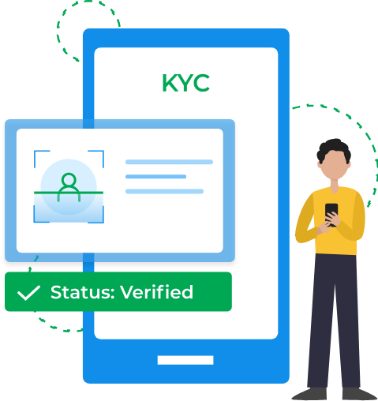
Introduction
Project Summary: Migrating an existing Angular application to a newer version to enhance CKYC management in banking. Integrating TrackWizz from TSS Consultancy to streamline customer notifications and ensure regulatory compliance. The upgrade improves performance, security, and multi-channel communication with thorough testing and validation.

Slide 4
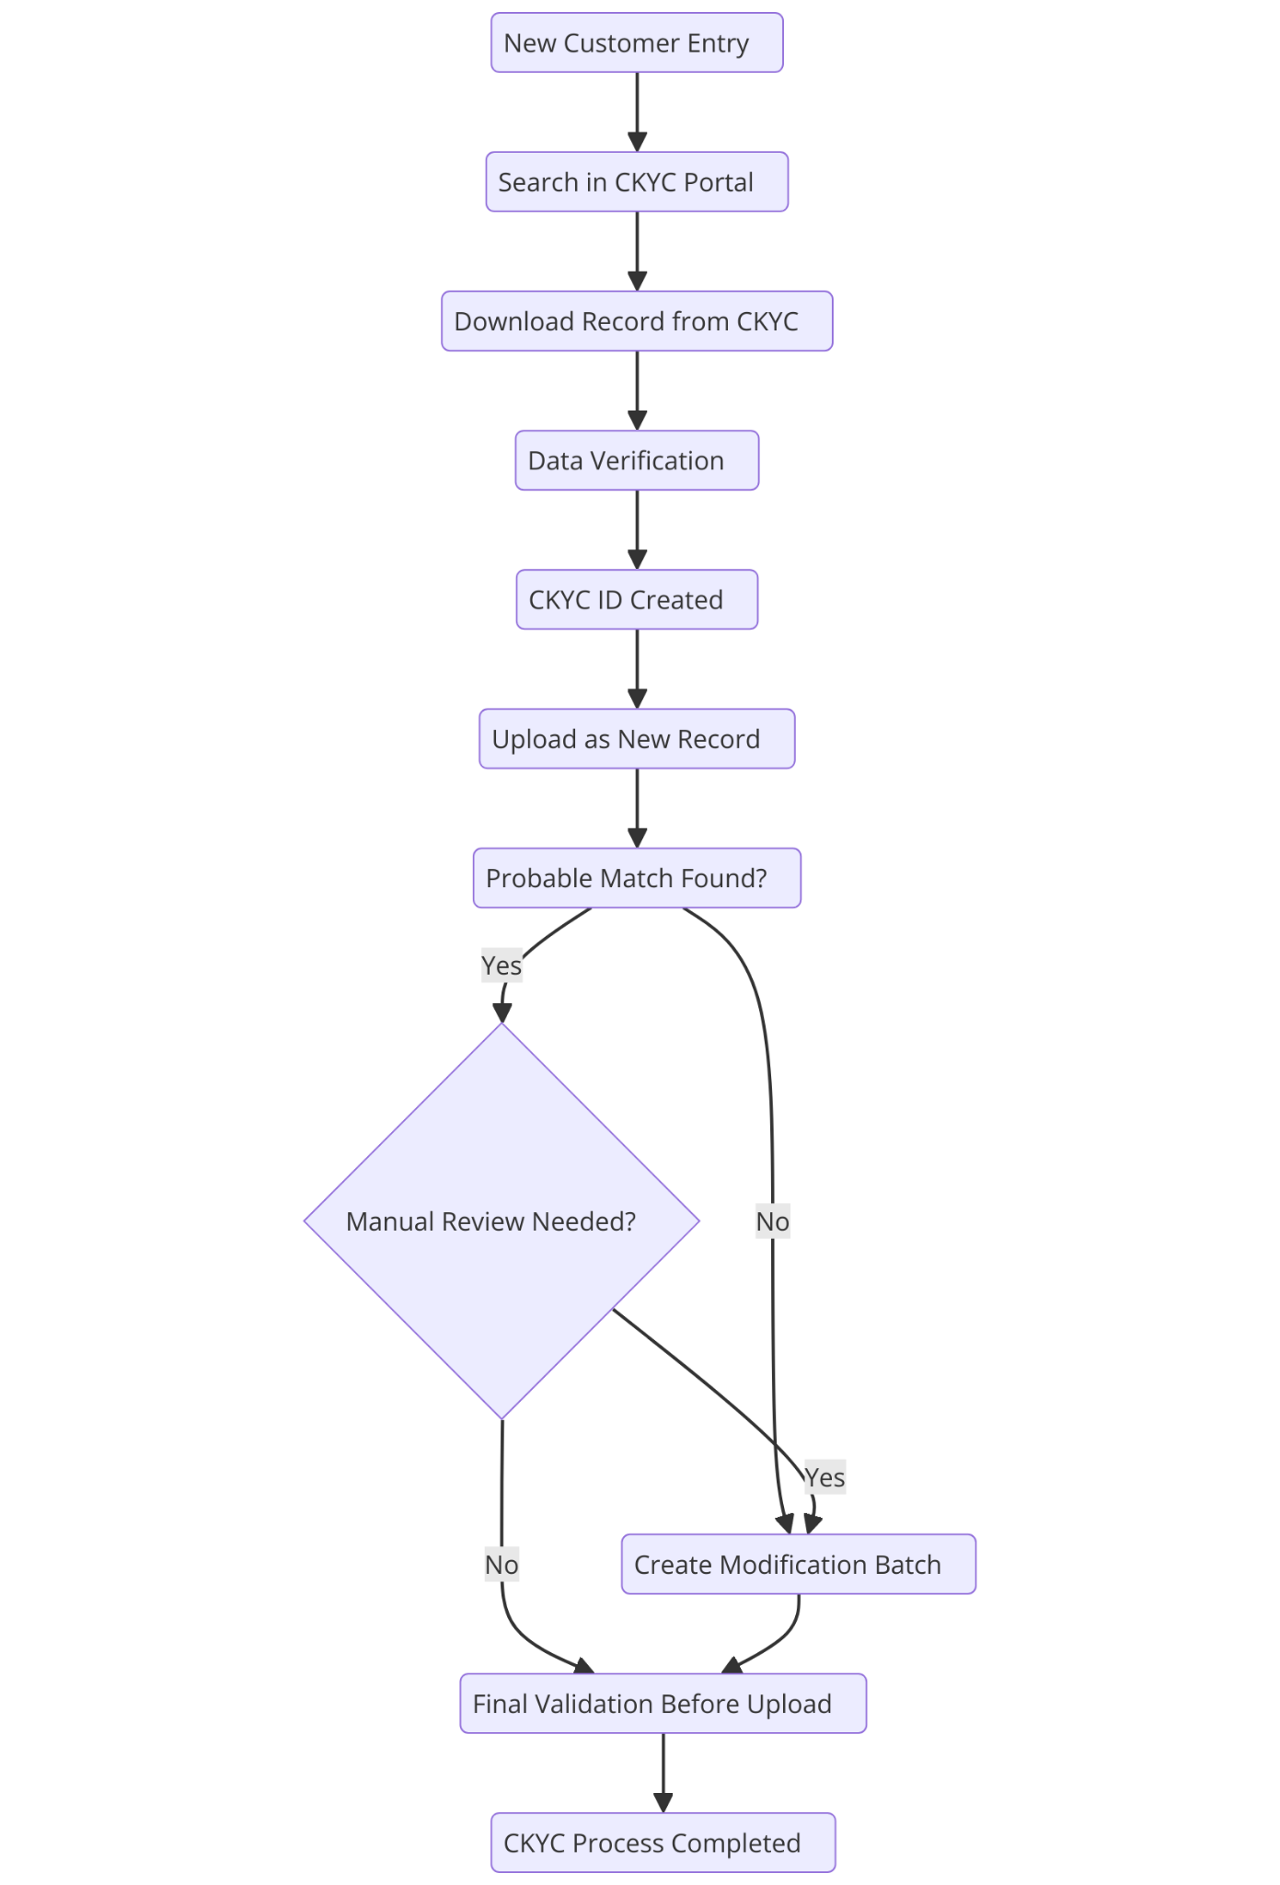
Project Workflow
Summary of CKYC Process Workflow:
New Customer Entry → Search in CKYC Portal → Download Record from CKYC
Data Verification → CKYC ID Created → Upload as New Record
Check for Probable Match
If No Match Found, proceed to the next step.
If Match Found, determine if Manual Review is Needed.
If Manual Review is Not Needed, proceed to Final Validation Before Upload.
If Manual Review is Needed, determine if Modification is Required.
If Yes, create a Modification Batch and proceed to Final Validation Before Upload.
If No, go directly to Final Validation Before Upload.
CKYC Process Completed.

Slide 5

Training Progress Report
Week-wise Breakdown of Tasks
Harshil Joshi
Date: [28 Feb 2025]

Slide 6
Week 1
Introduction to TSS and HR Activities
Client and Product Overview Training
IT Induction and Security Awareness Training
CKYC Overview for Trackwizz
Debugging the CKYC Project

Slide 7
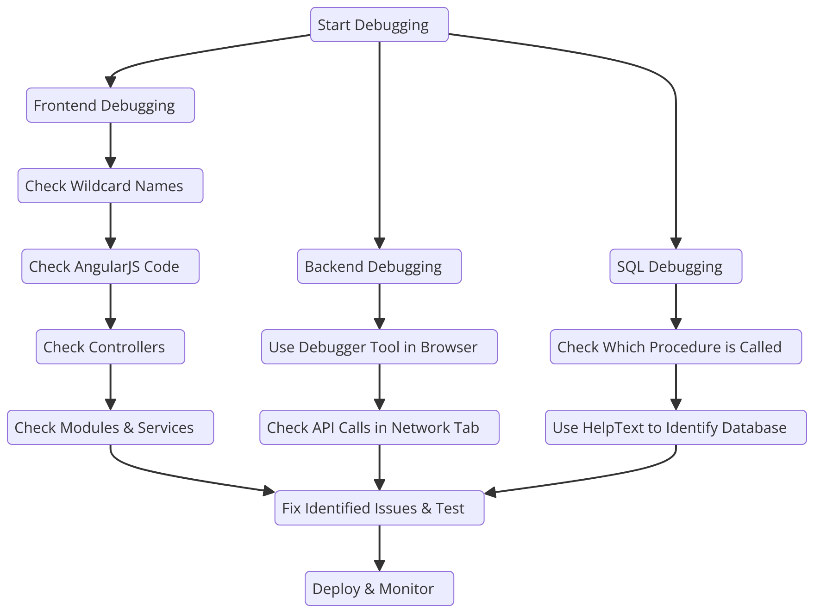
Debugging workflow

Slide 8
Week 2
Continued Debugging
Frontend Training
Advanced JavaScript Training (Event Bubbling, JSON Handling)
CRUD Operations & DOM Manipulation
Dice Board Game Development

Slide 9
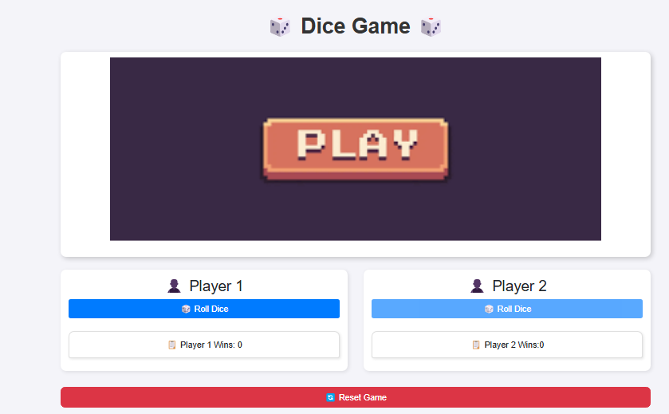
Task-Outcome

Slide 10
Week 3
Enhancing Dice Board Game
Introduction to Angular (Component-based Architecture, TypeScript)
Angular Services and Routing
API Integration in Angular
Advanced Angular Concepts

Slide 11
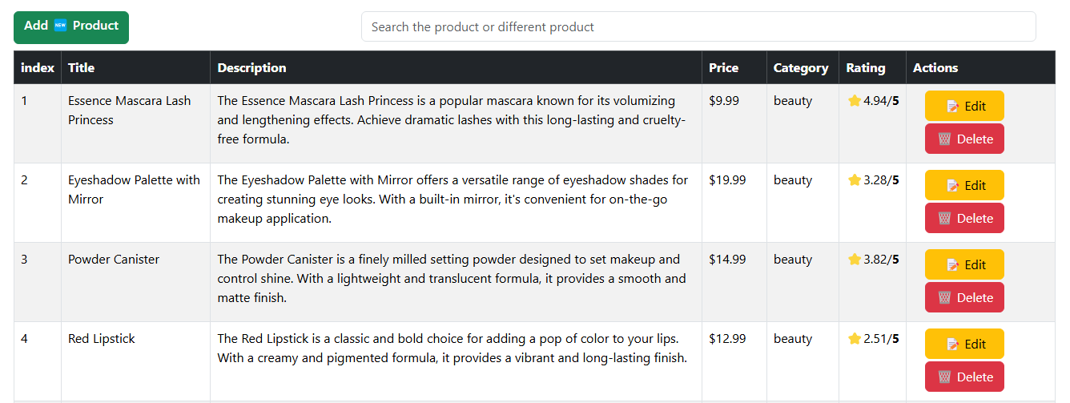
Task-Outcome

Slide 12
Week 4
UI Enhancements with Angular Material
Advanced Routing & Pagination
Snapshot & Navigation Handling
Route Guards & Async Data Handling
Login Implementation & Conditional Rendering

Slide 13
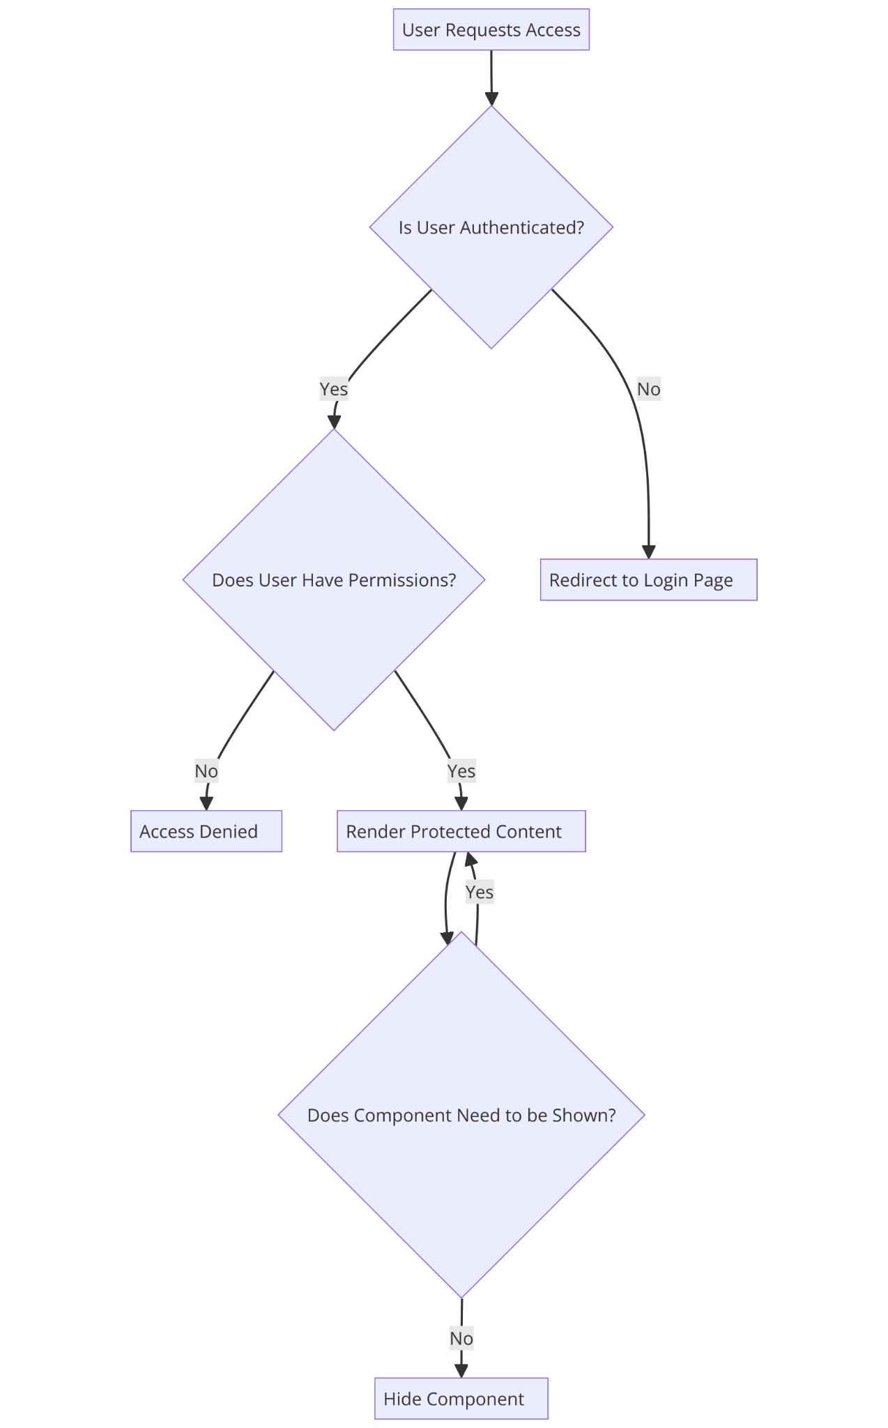
Task Flow
Summary of Flow:
User Requests Access
A user tries to access a page or a component
Is User Authenticated?
If No, the system redirects the user to the login page.
If Yes, proceed to check permissions.
Does User Have Permissions?
If No, access is denied.
If Yes, the protected content is rendered.
Does Component Need to be Shown? (Conditional Rendering)
If Yes, the component is displayed.
If No, the component remains hidden.

Slide 14
Week 5
Understanding Angular Reactive Forms
Registration Form Implementation with Reactive Forms
CRUD Operations & API Integration
Performance Optimization & Testing

Slide 15
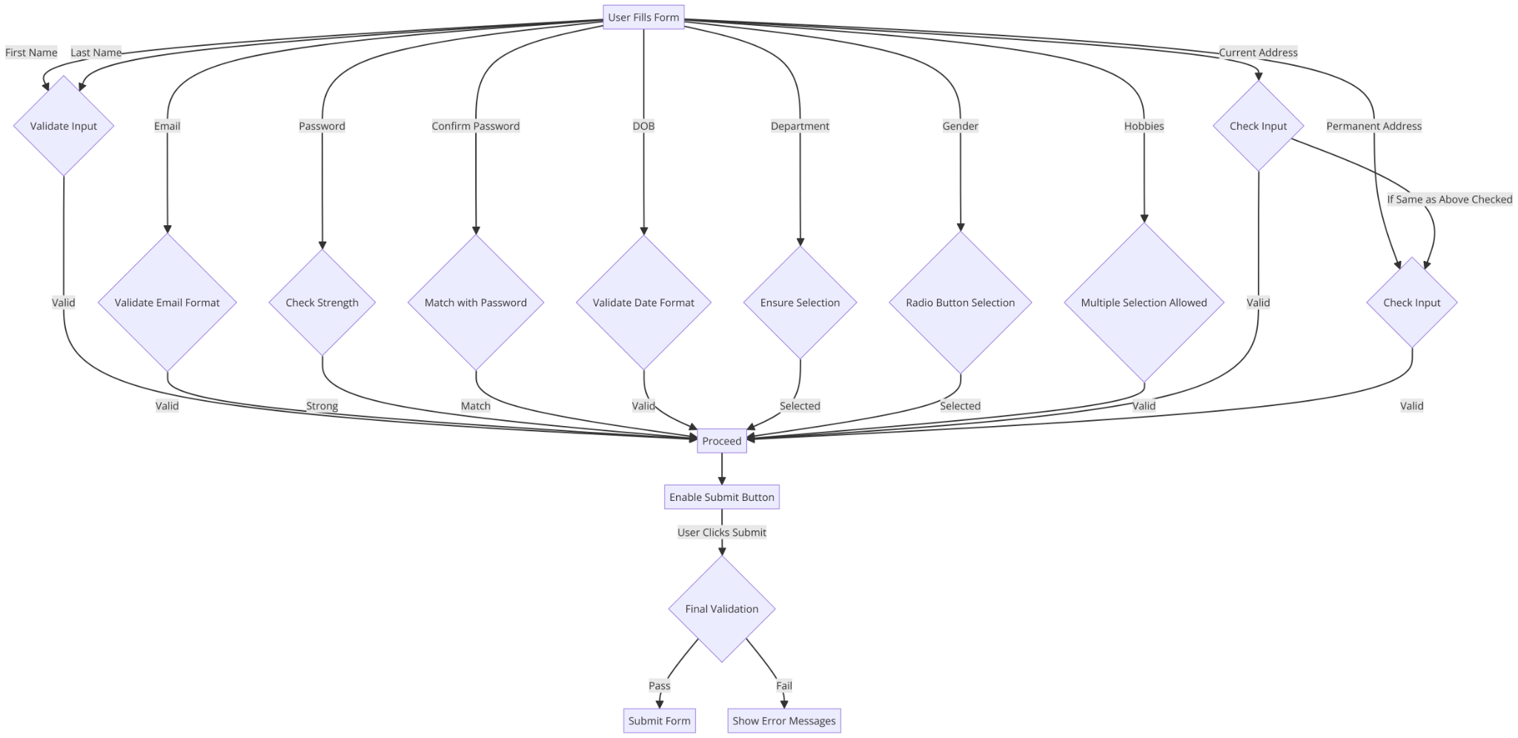
Task Flow

Slide 16
Week 6
Module Migration: UI Data Loading
Service Integration & Async Handling
Using HTTP Methods (GET, POST, PUT, DELETE)
Lazy Loading & Code Splitting
Advanced Form Handling & Dynamic Validations
Final Testing & Deployment Preparation

Slide 17
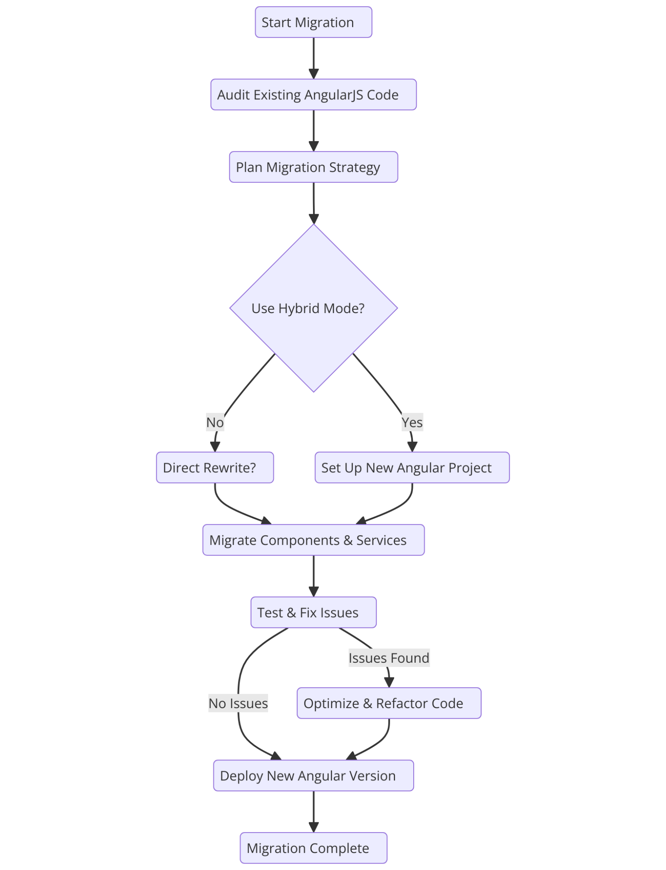
Migration Workflow
Summary of AngularJS to Angular Migration Workflow:
Start Migration → Audit Existing AngularJS Code → Plan Migration Strategy
Decide whether to Use Hybrid Mode
If Yes, Set Up New Angular Project
If No, decide on Direct Rewrite
Migrate Components & Services
Test & Fix Issues
If Issues Found, Optimize & Refactor Code
If No Issues, proceed directly to deployment
Deploy New Angular Version
Migration Complete.

Slide 18
Conclusion
Key Learnings & Skills Gained
Gained expertise in frontend (Angular, JavaScript, API integration), backend debugging, security best practices, and project collaboration. Strengthened problem-solving, communication, and performance optimization skills.

Slide 19


